Slide 1
Additive manufacturing technologies
Martin Hejtmánek
Technologie 3D tisku

Slide 2
Goals of bachelor thesis
Description - additive manufacturing technologies and process engineering
Research - commercially available AM technologies
Experiment - effect of FDM print parameters on tensile strength of printed parts
(Injection molding vs. Additive manufacturing)

Slide 3
Additive manufacturing and process engineering
Non / Newtonian fluid flow – Material jetting, FDM filament melting
Heat flow – Rapid cooling rates (thermal stresses, shrinkage problem)
Mass flow – Fusion of particles in SLS heated chambers
Chemical reactions – Photopolymerization, inert atmosphere

Slide 4
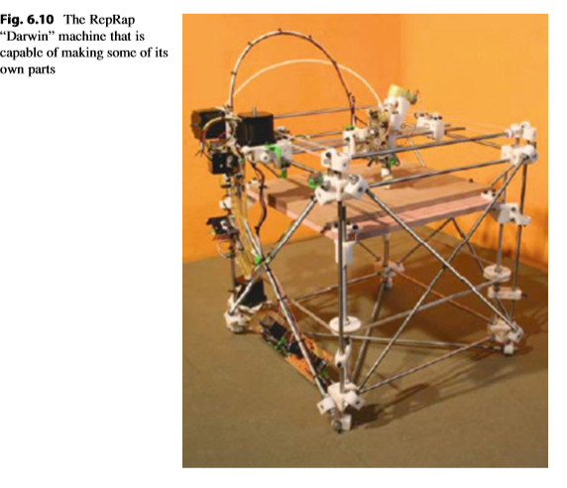

Slide 5
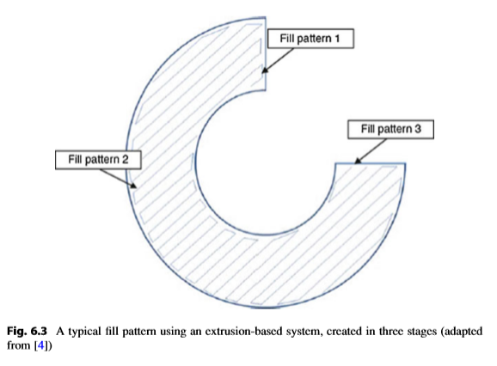

Slide 6
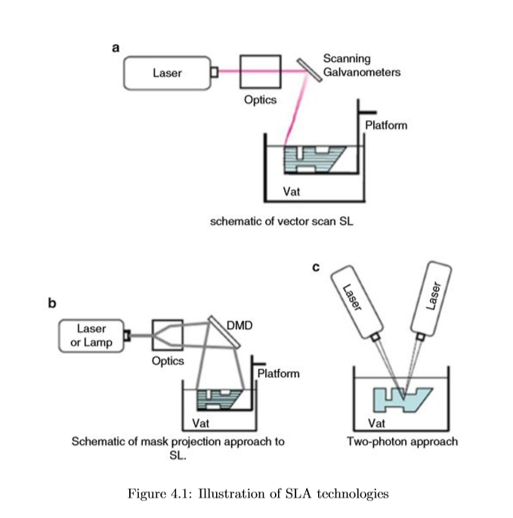

Slide 7
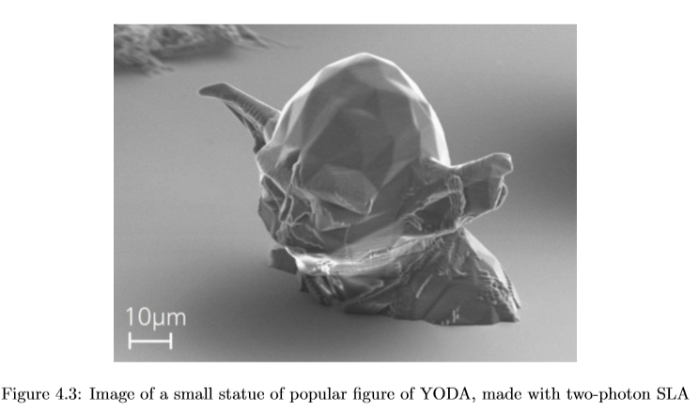

Slide 8
Available AM technologies
Photopolymerization
Fused deposition modeling
Powder bed fusion
Sheet lamination
Material jetting
Binder jetting
Directed energy deposition processes

Slide 9
Experimental part
Print parameters:
Print temperature (220-250°C)
Layer thickness (0.1 – 0.25mm)
Infill raster orientation (45°-90°)
Infill percentage (100% full – 20% hollow)
Other parameters
Material / machine age
Print speed
Infill pattern
Used software

Slide 10
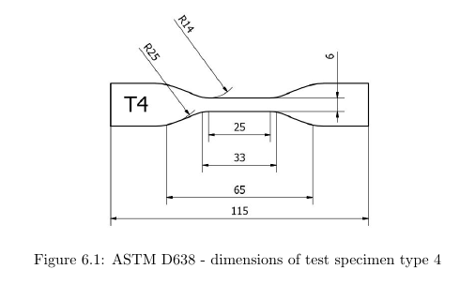

Slide 11
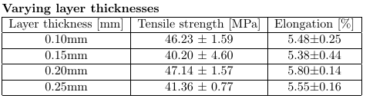
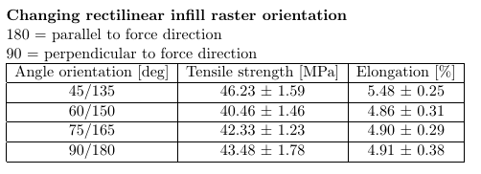
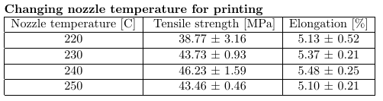
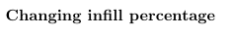
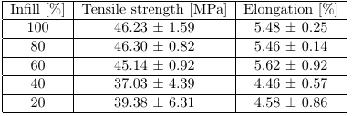

Slide 12
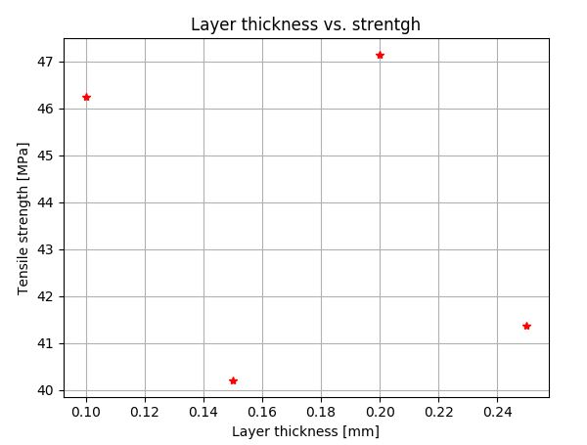
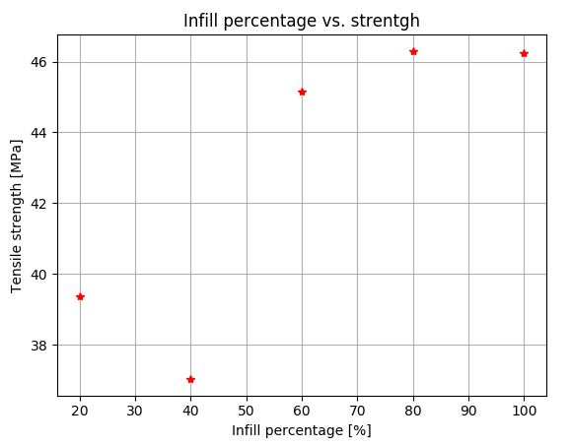
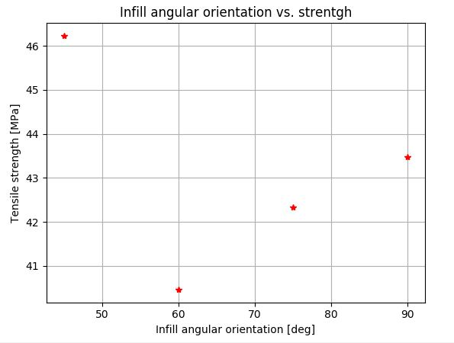
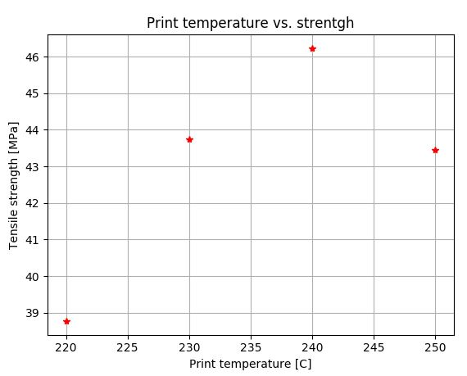
Results

Slide 13
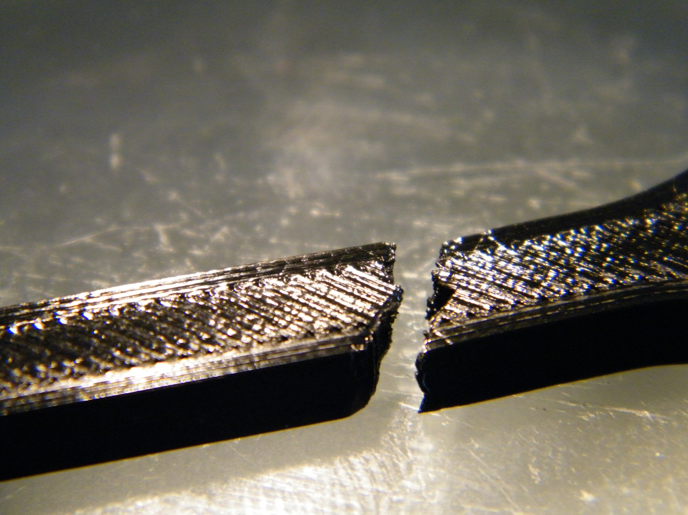

Slide 14
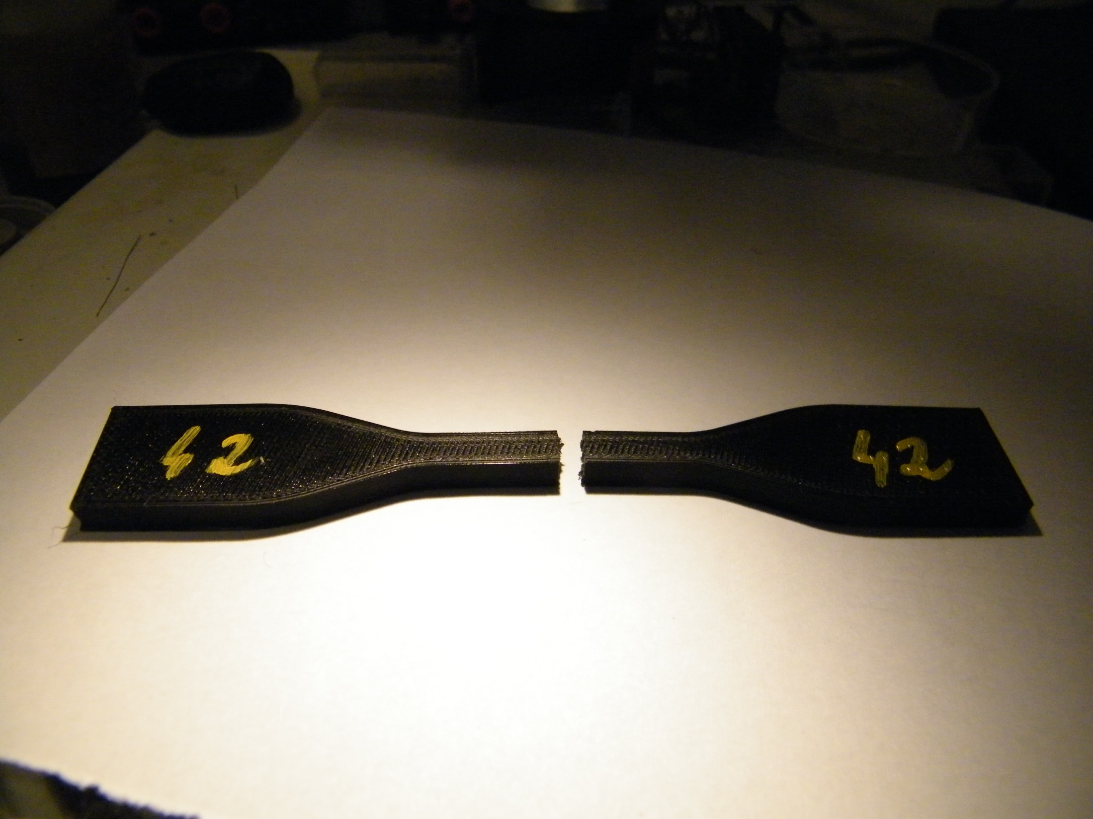

Slide 15
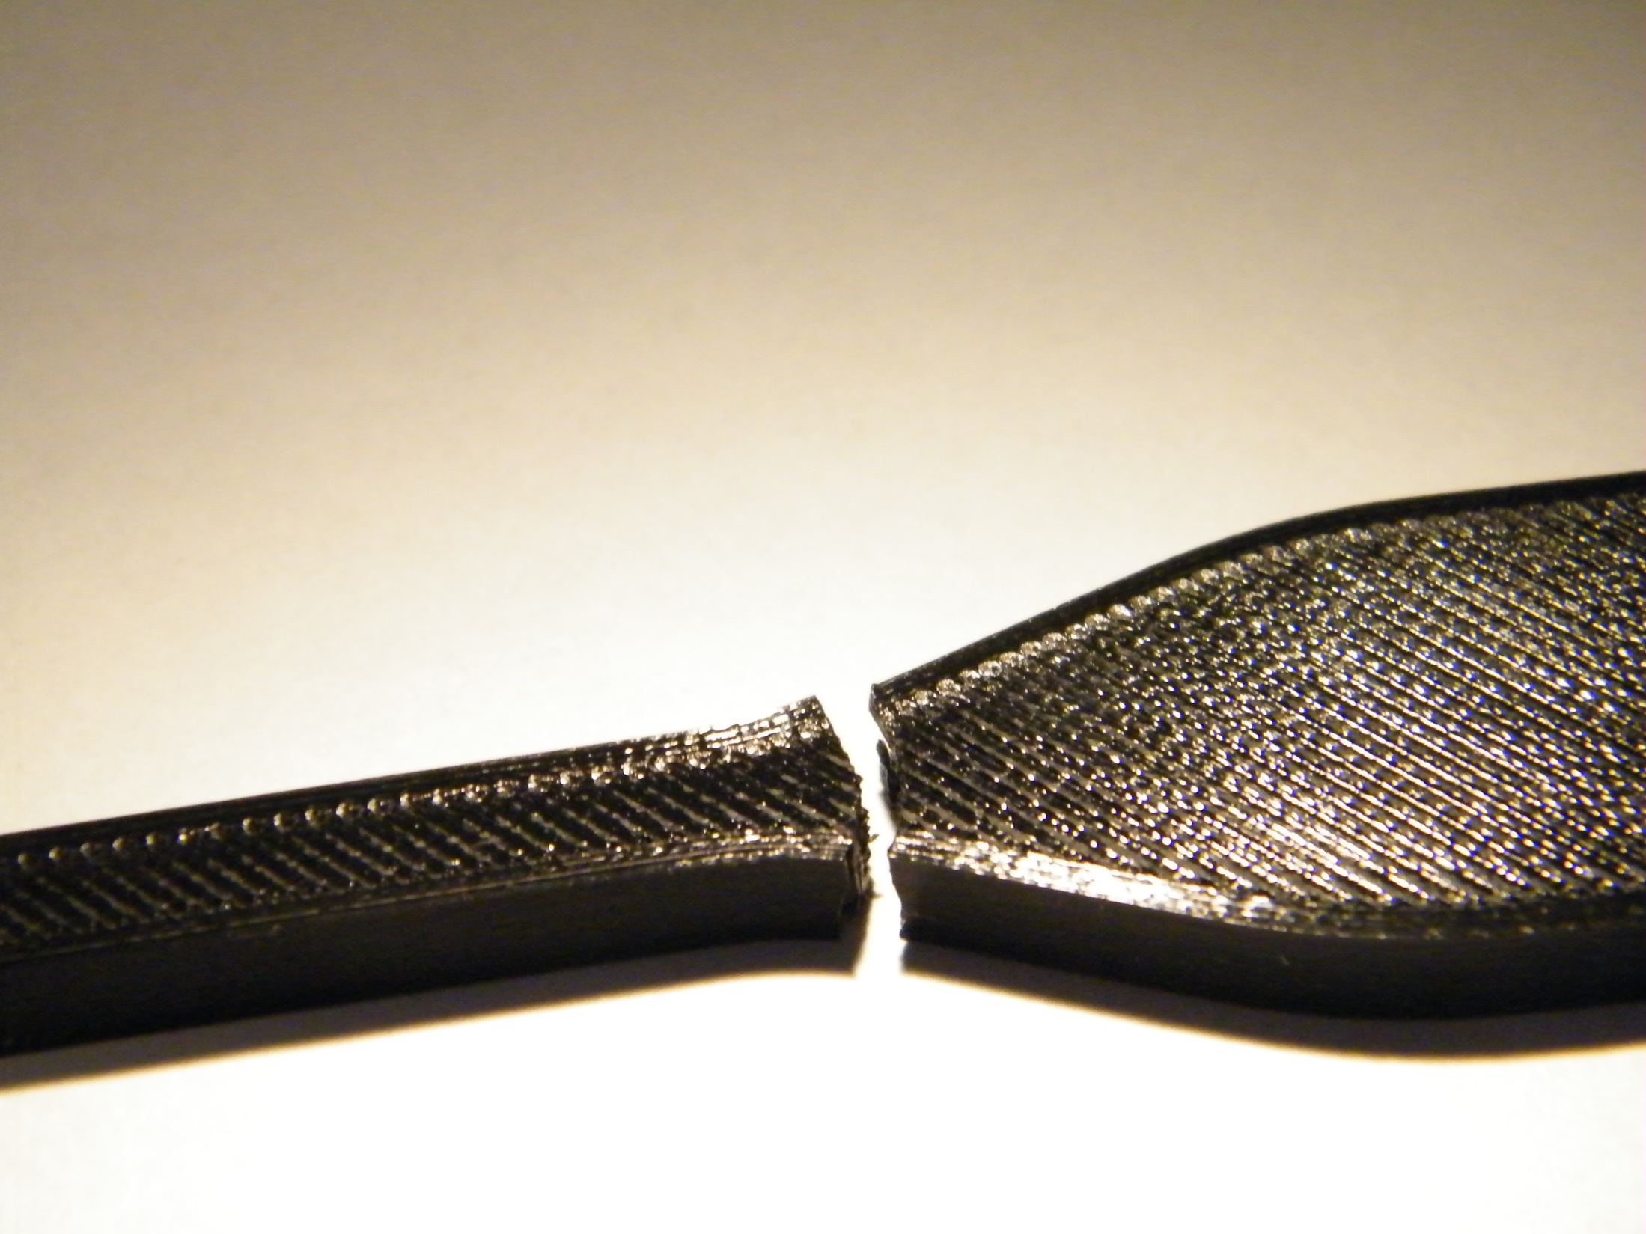

Slide 16
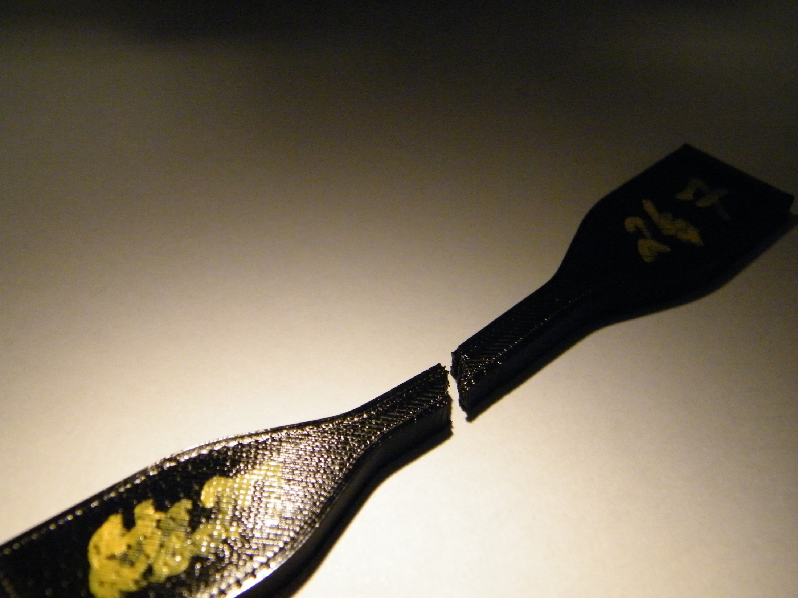

Slide 17
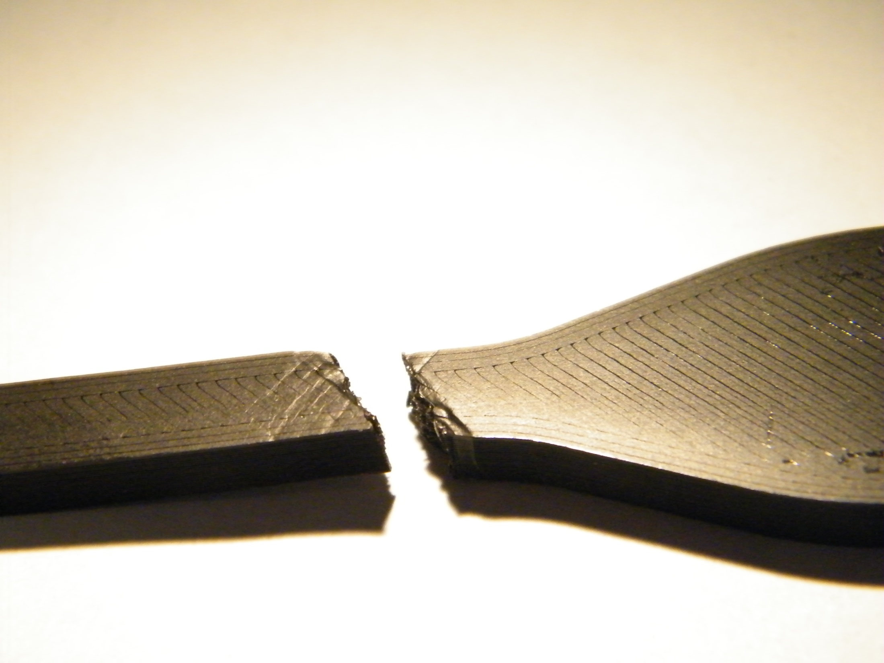

Slide 18
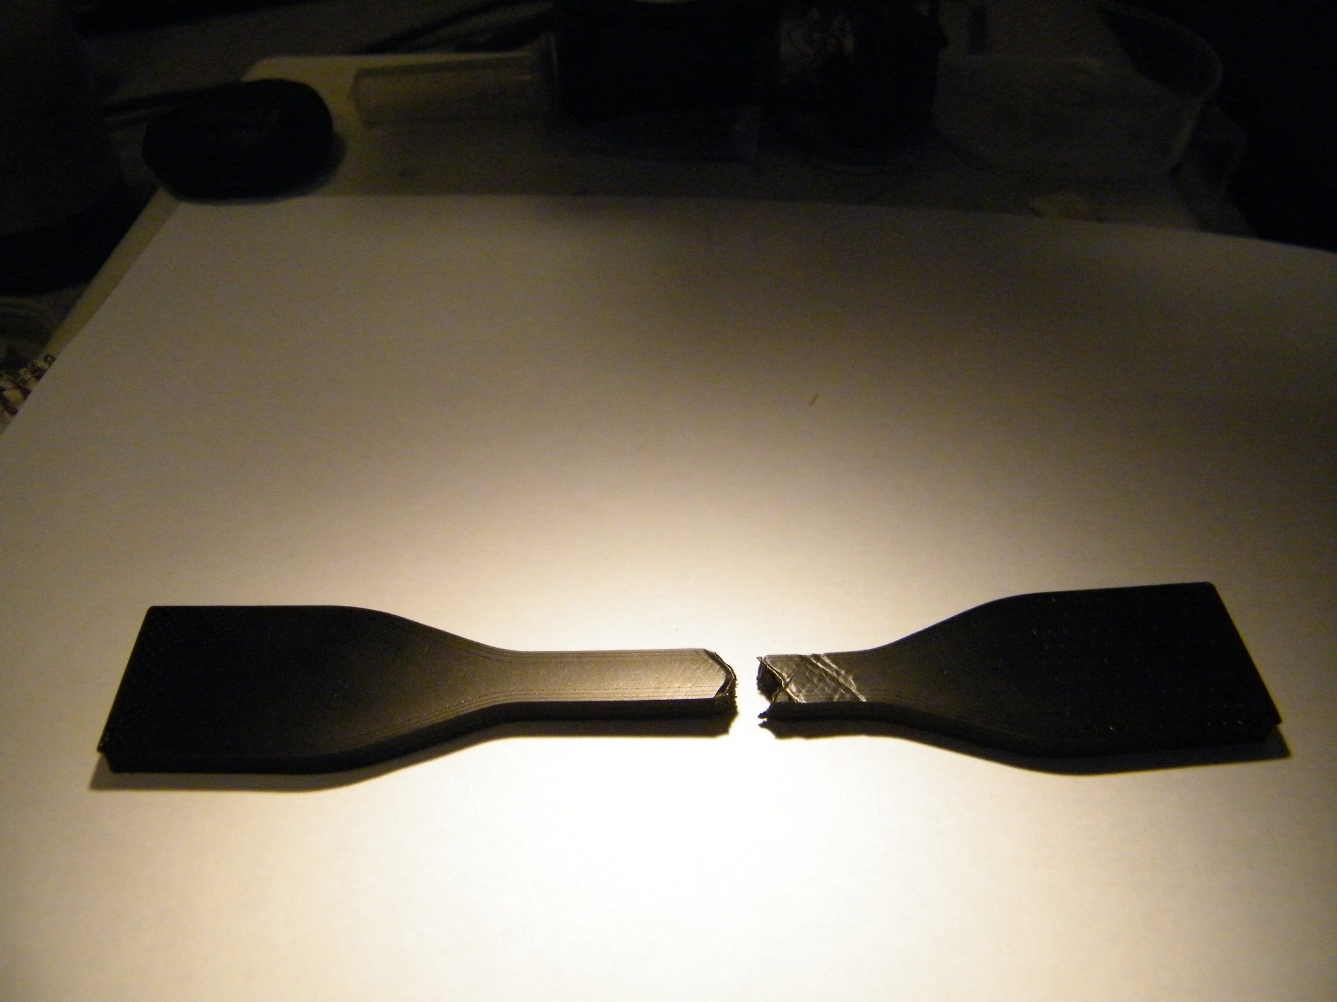

Slide 19
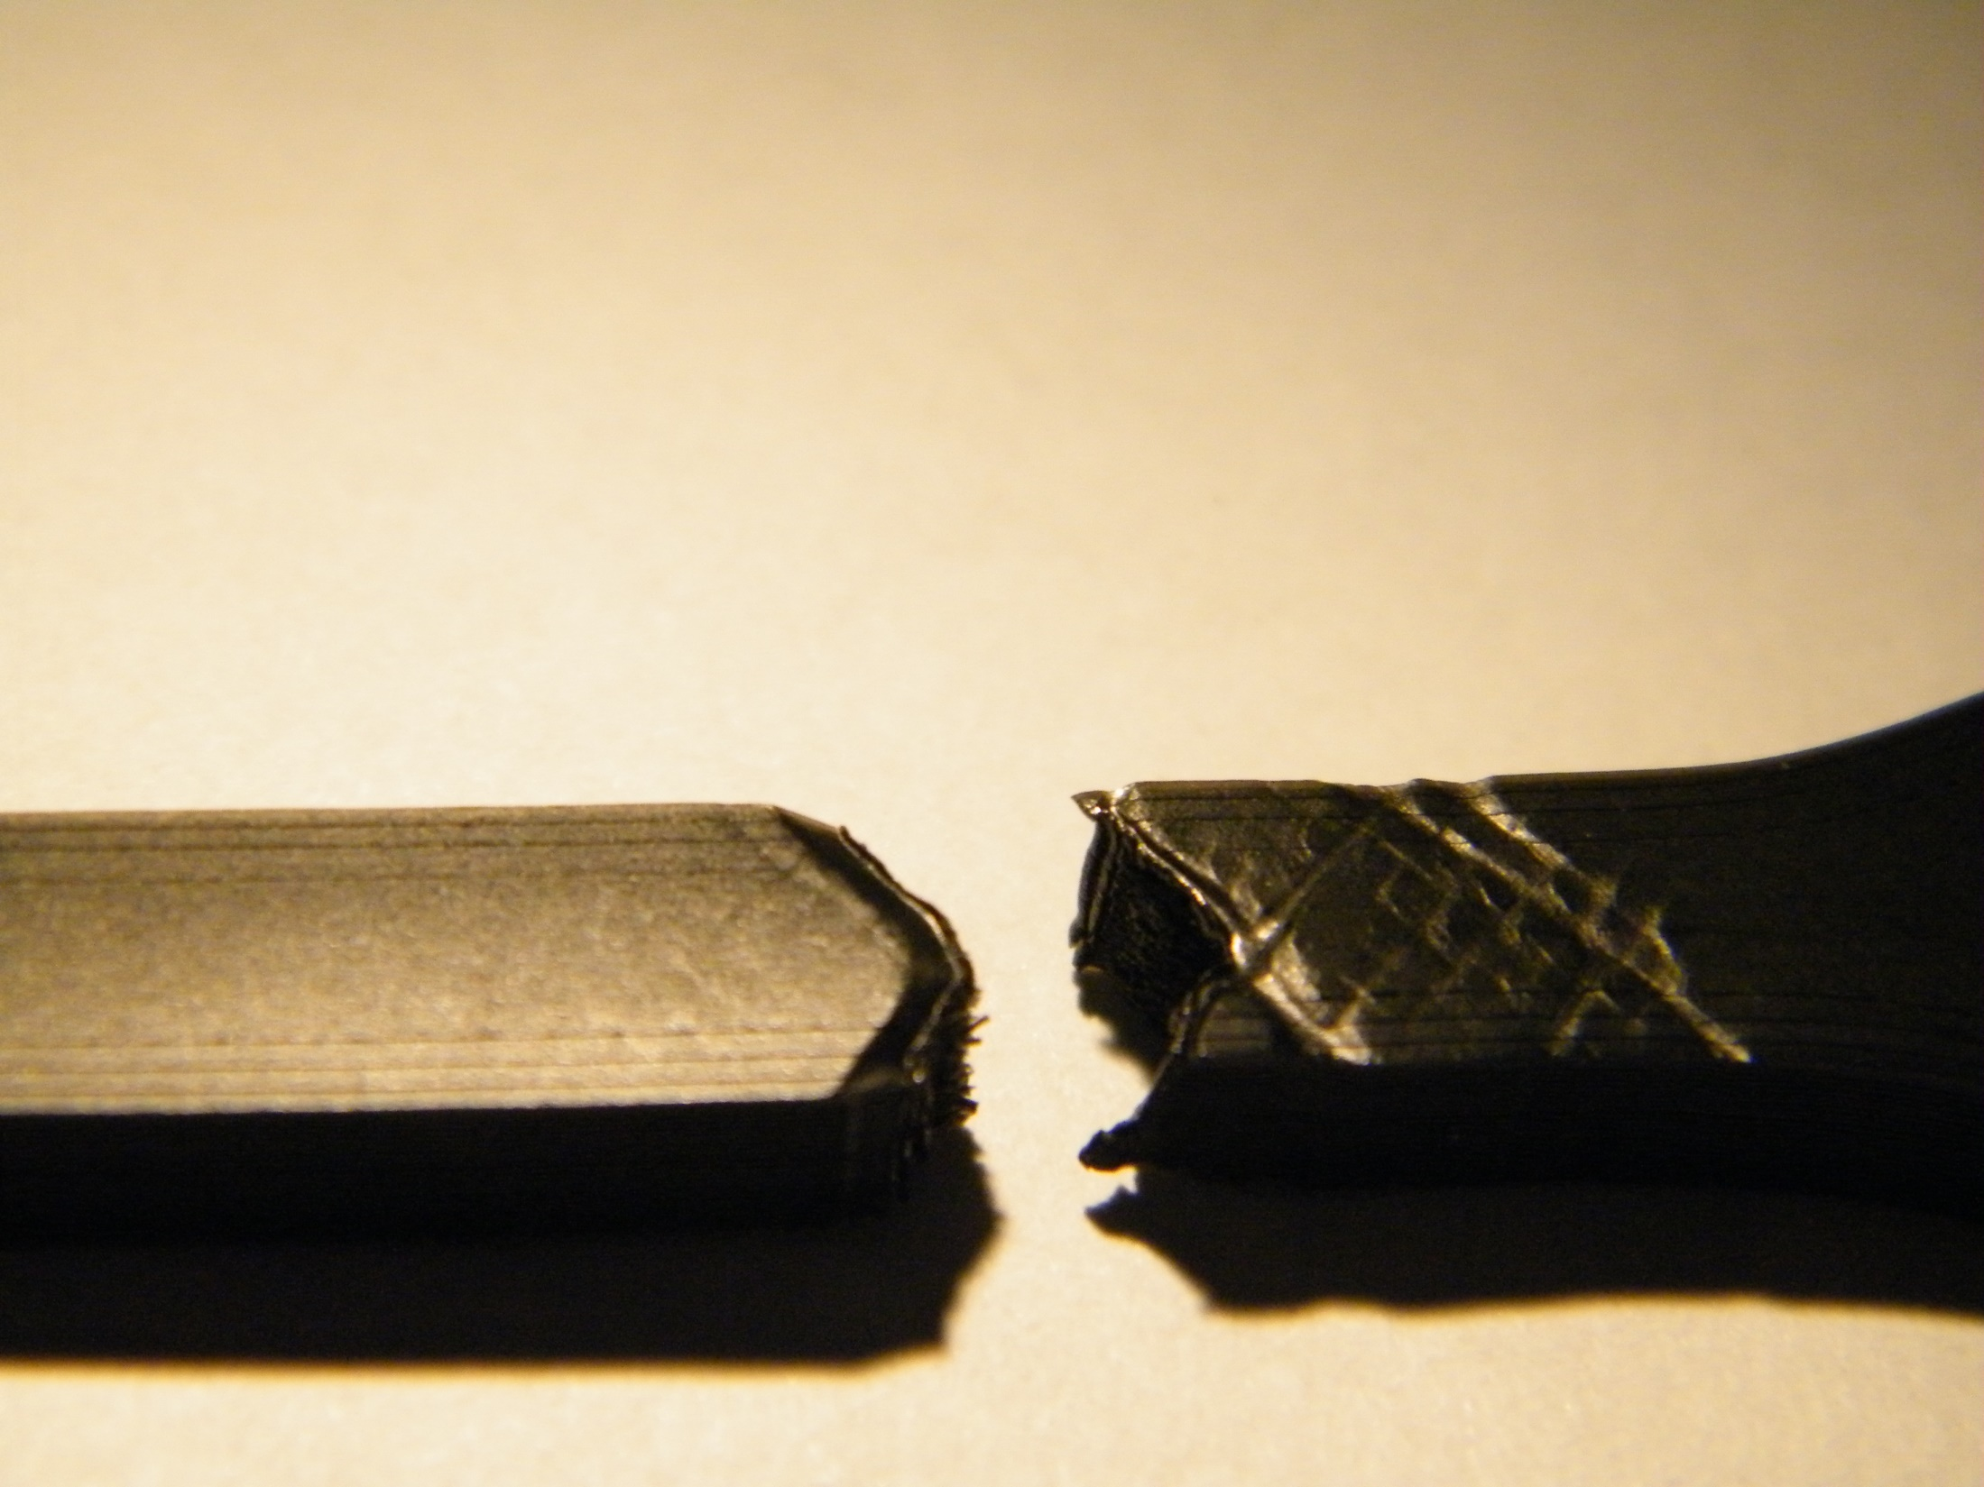

Slide 20
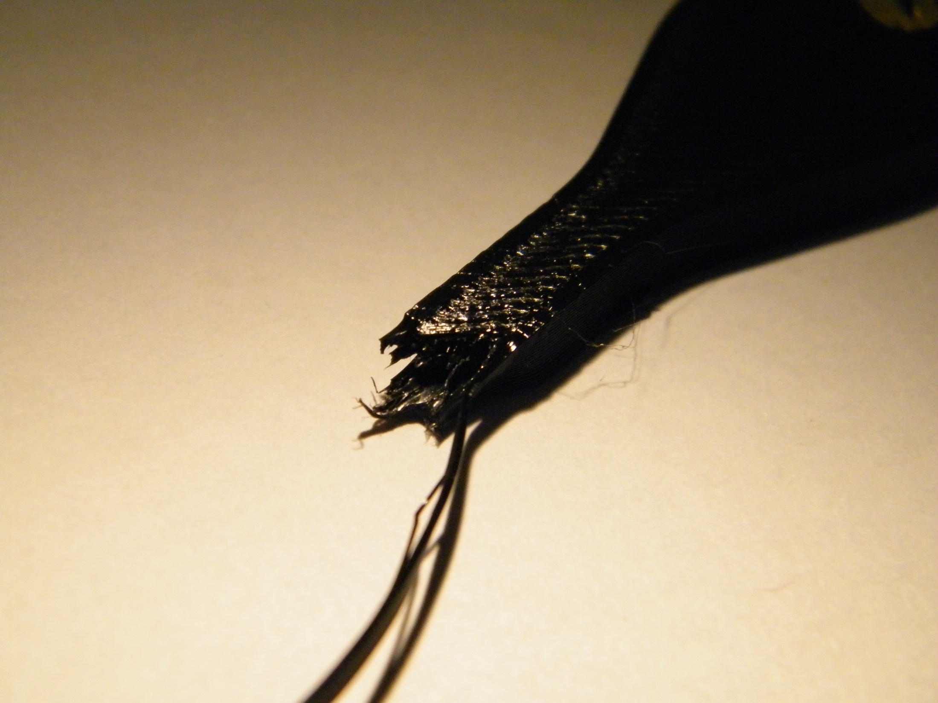

Slide 21
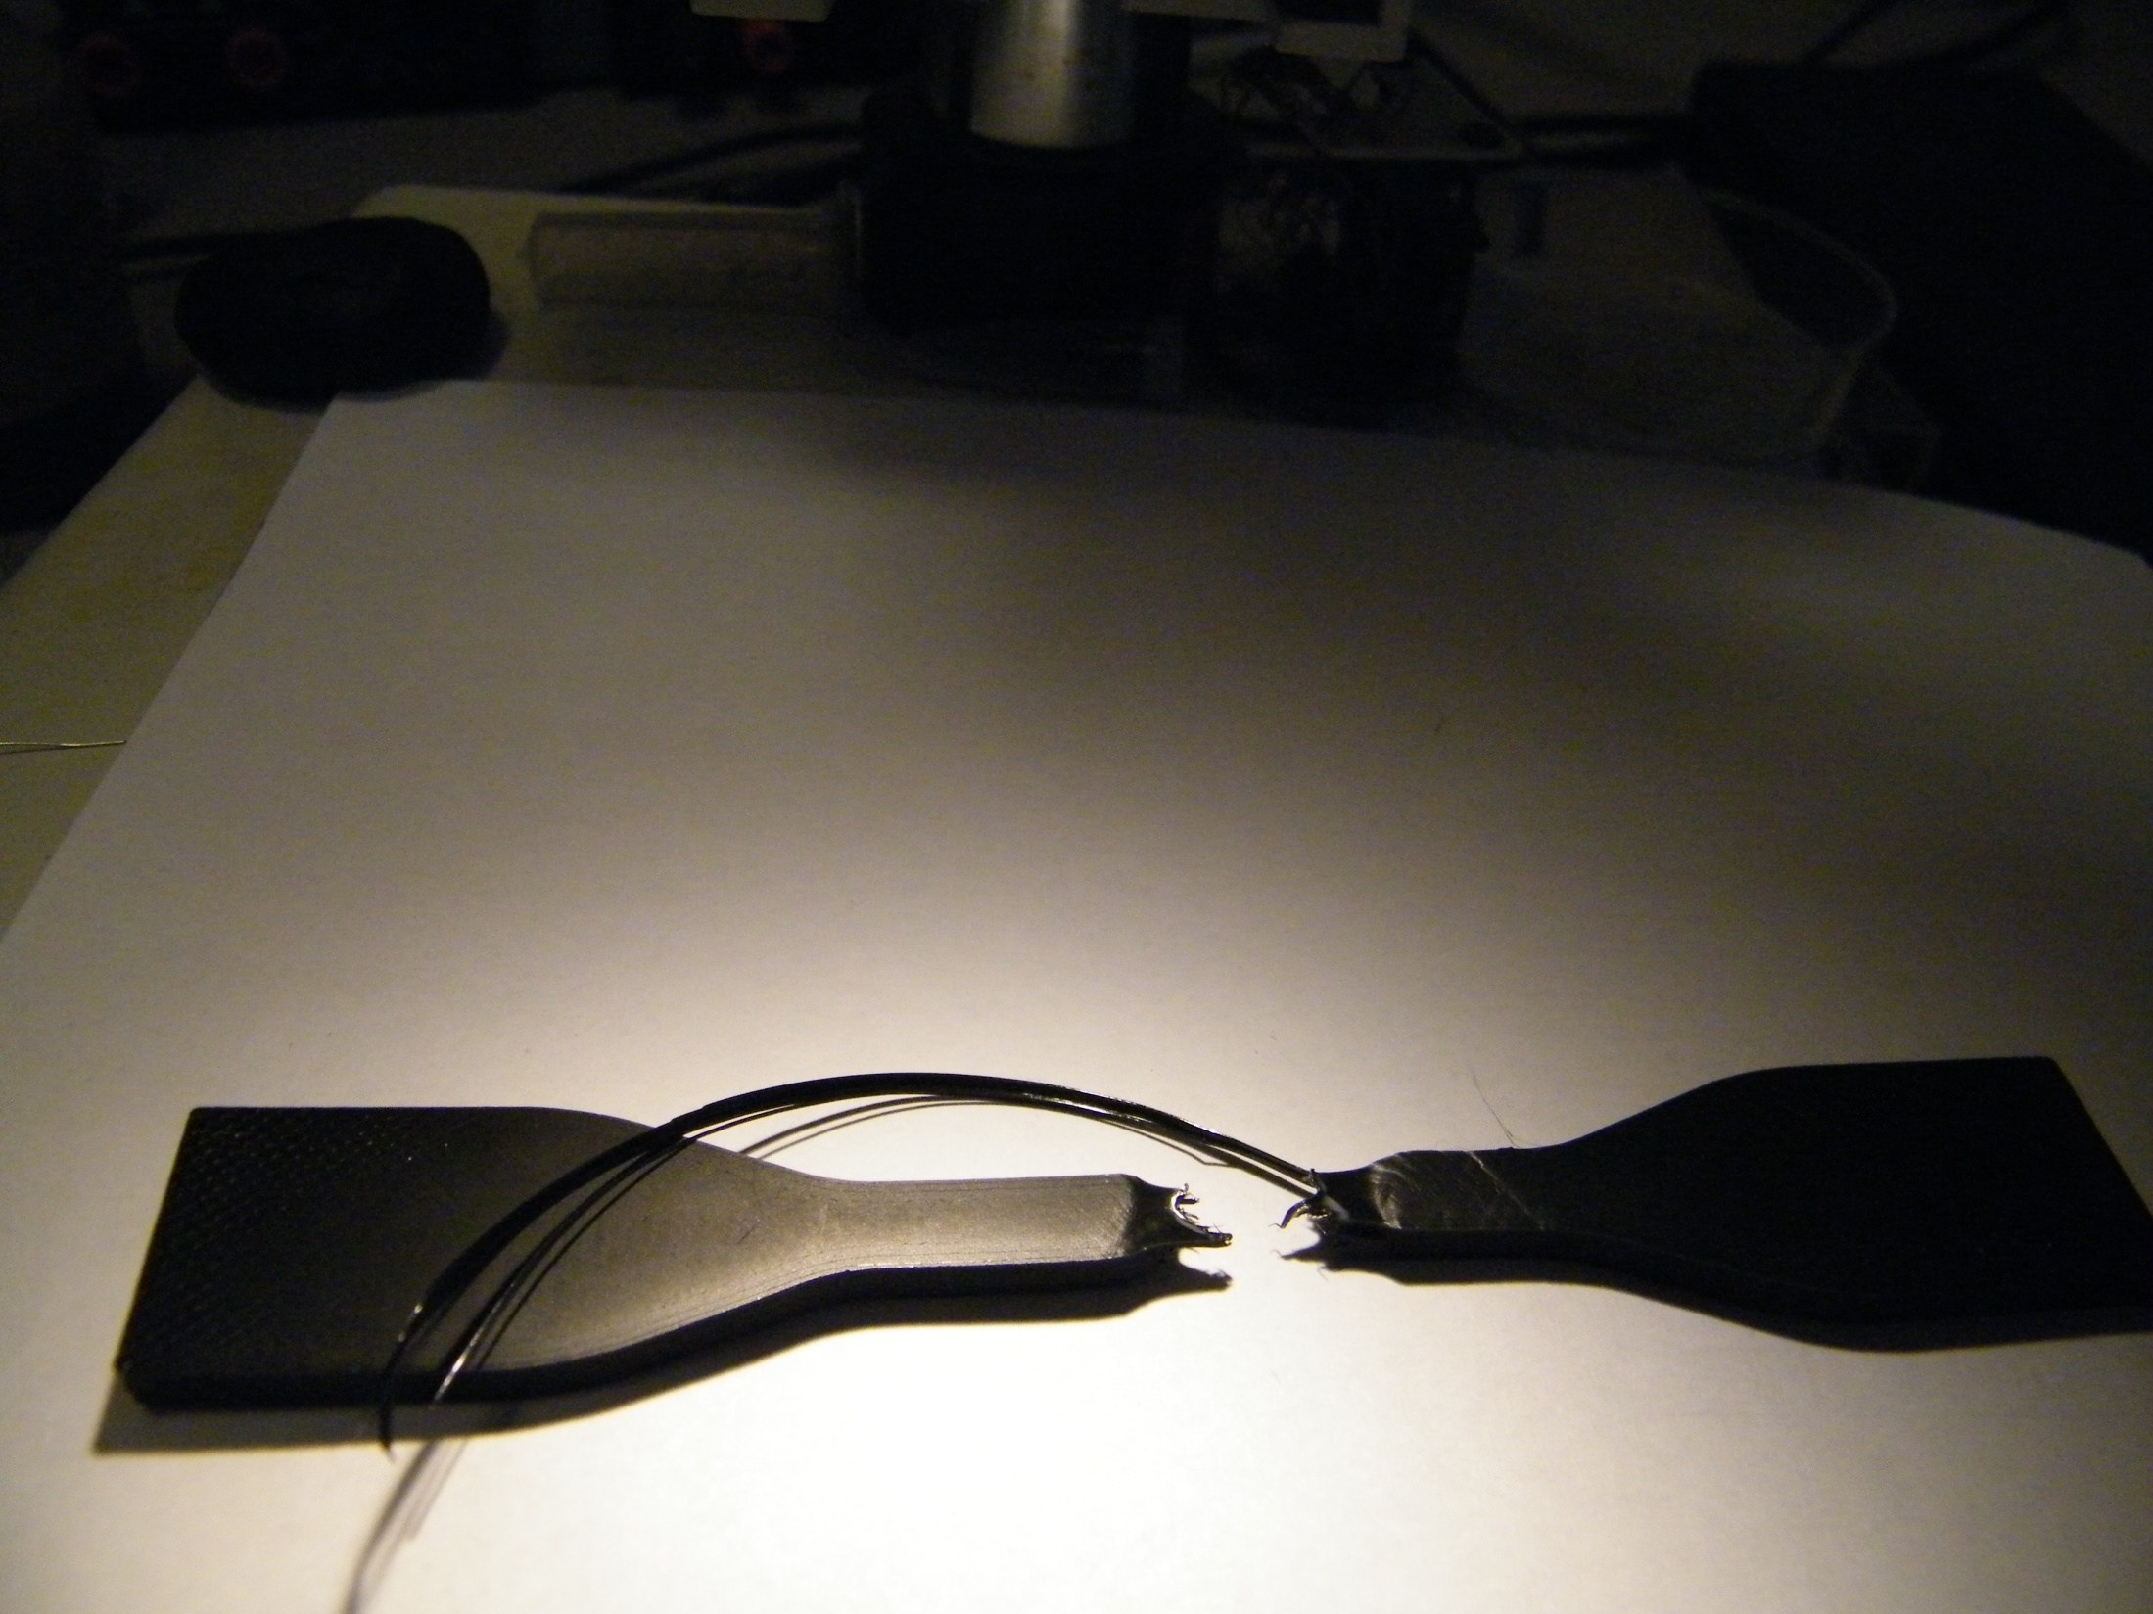

Slide 22
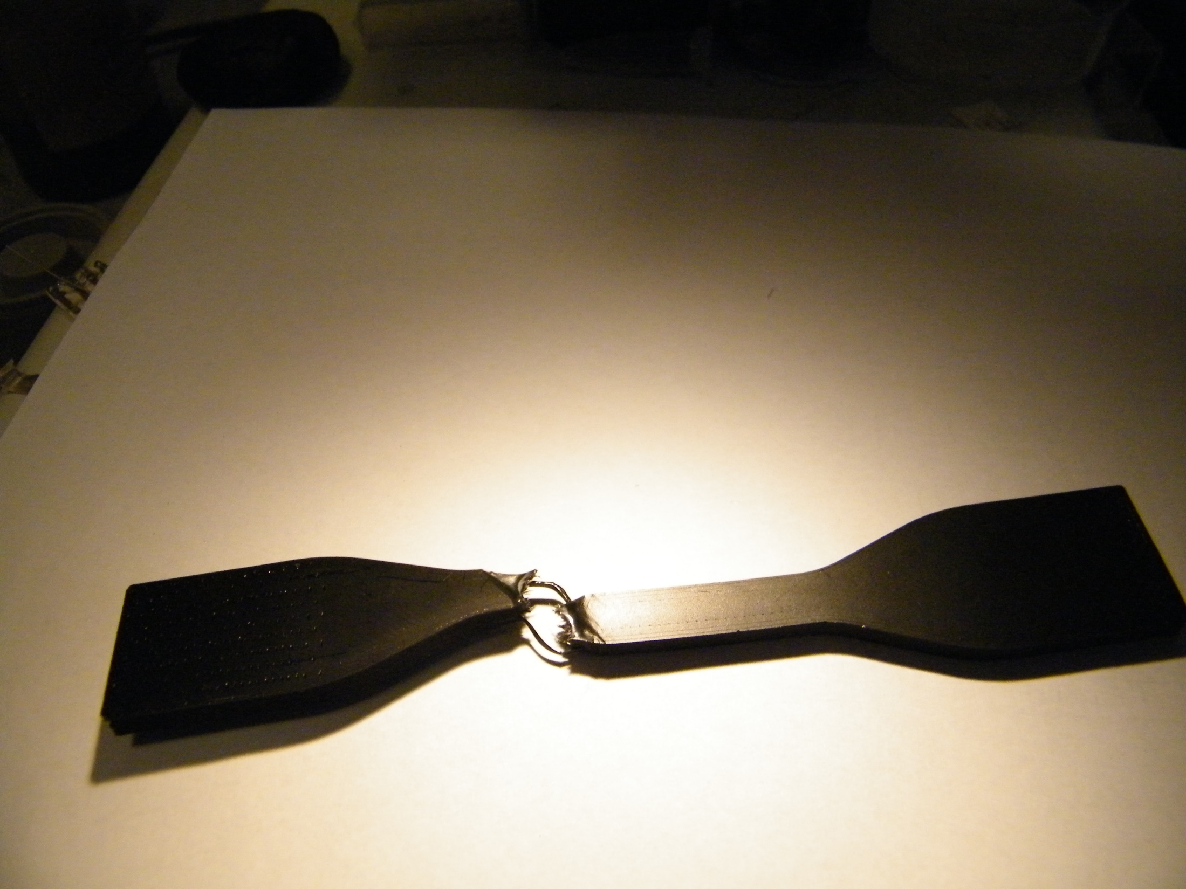

Slide 23
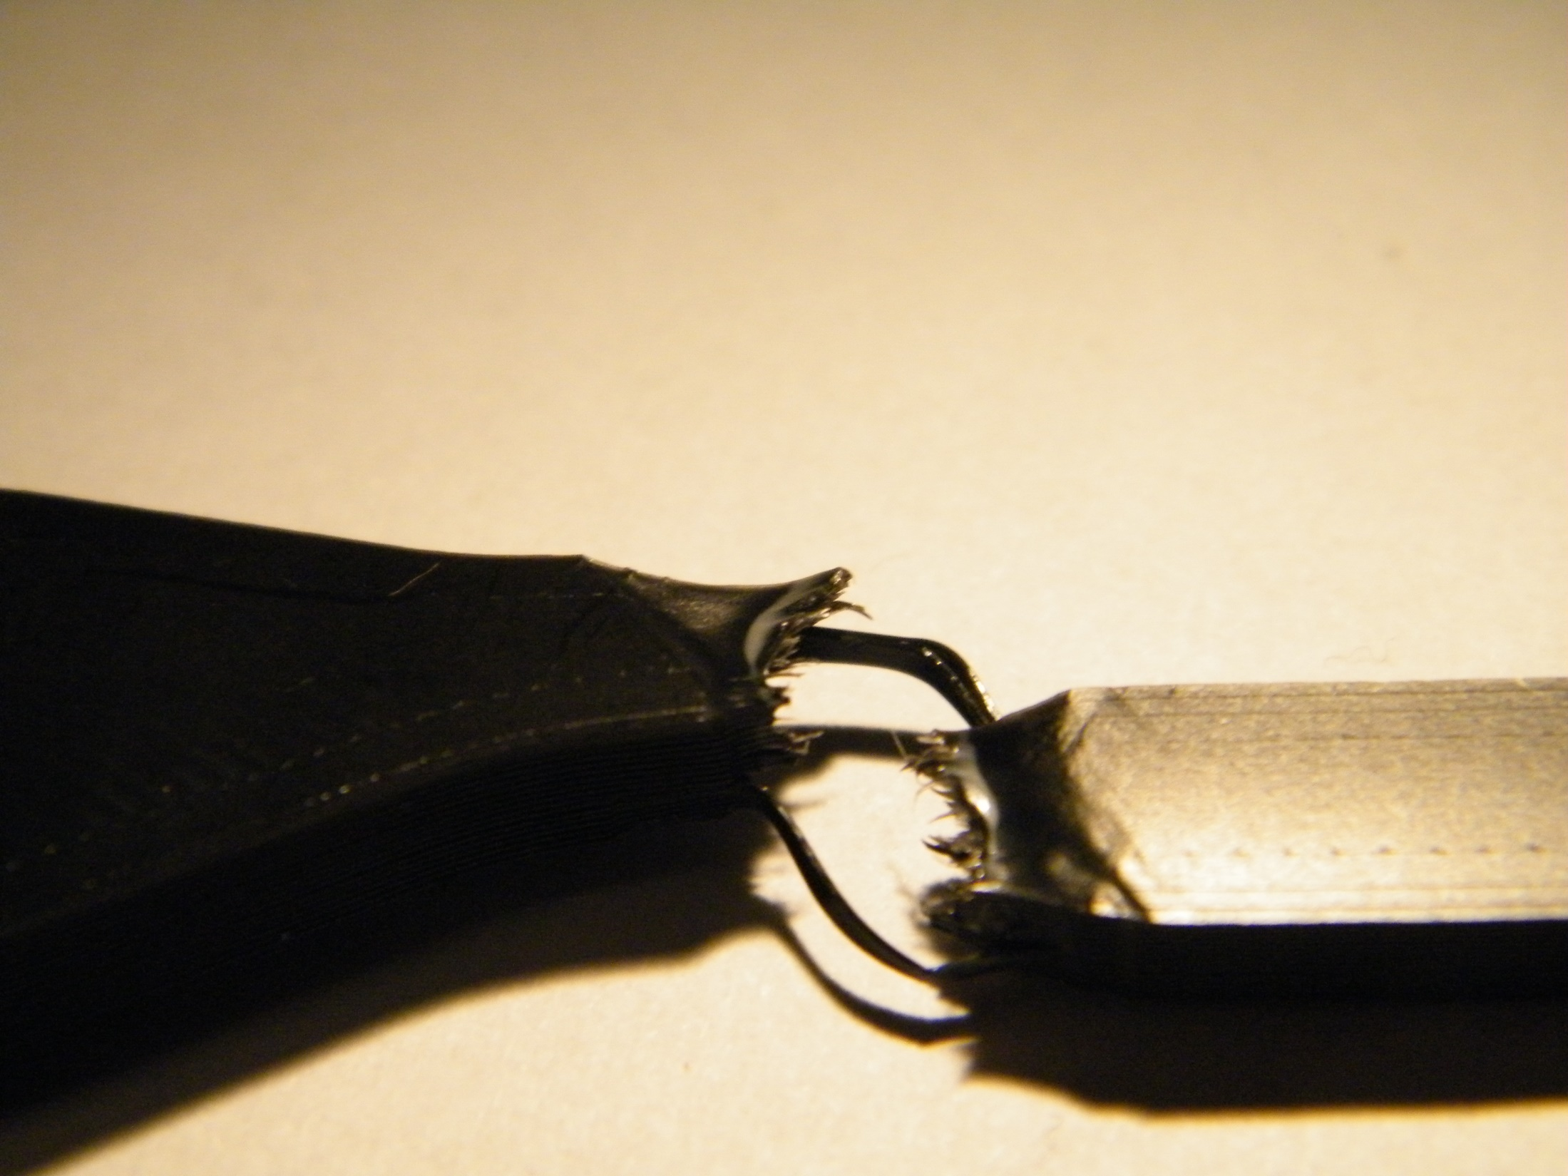

Slide 24
Thank you for your attention!

